Slide 1
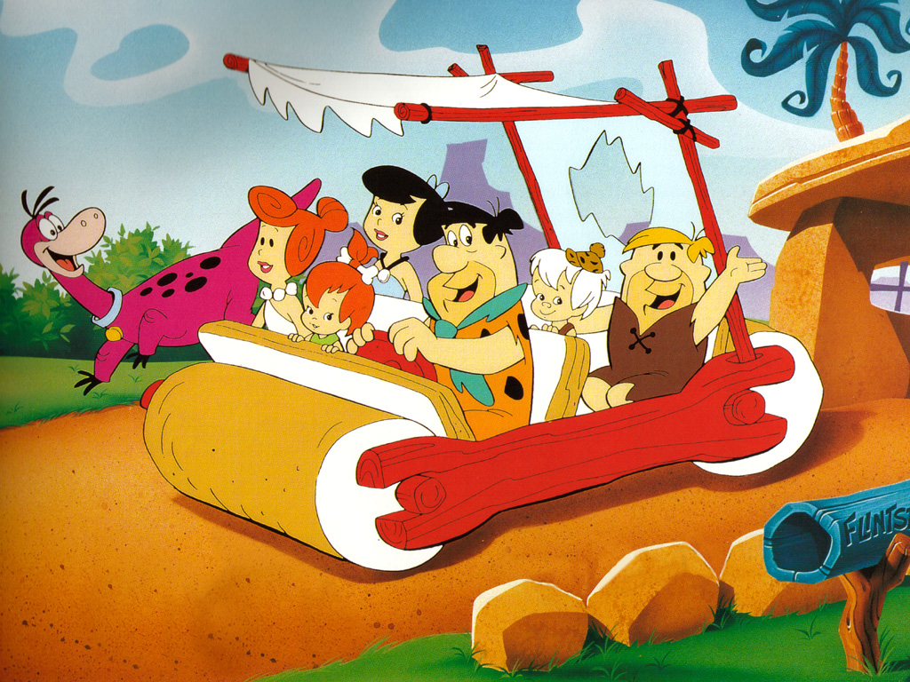
dr. Lars Moratis
An evolutionary psychology of (un)sustainable behavior
Notes:
1

Slide 2

“A very serious and carefully considered though at the same time somewhat lighthearted yet much-needed and arguably overdue contribution to SDG discourse (because someone needs to say it), humbly offered in the noble tradition of shouting into the void, where irony might be our last renewable resource and laughter the only sustainable form of hope left”

Slide 3
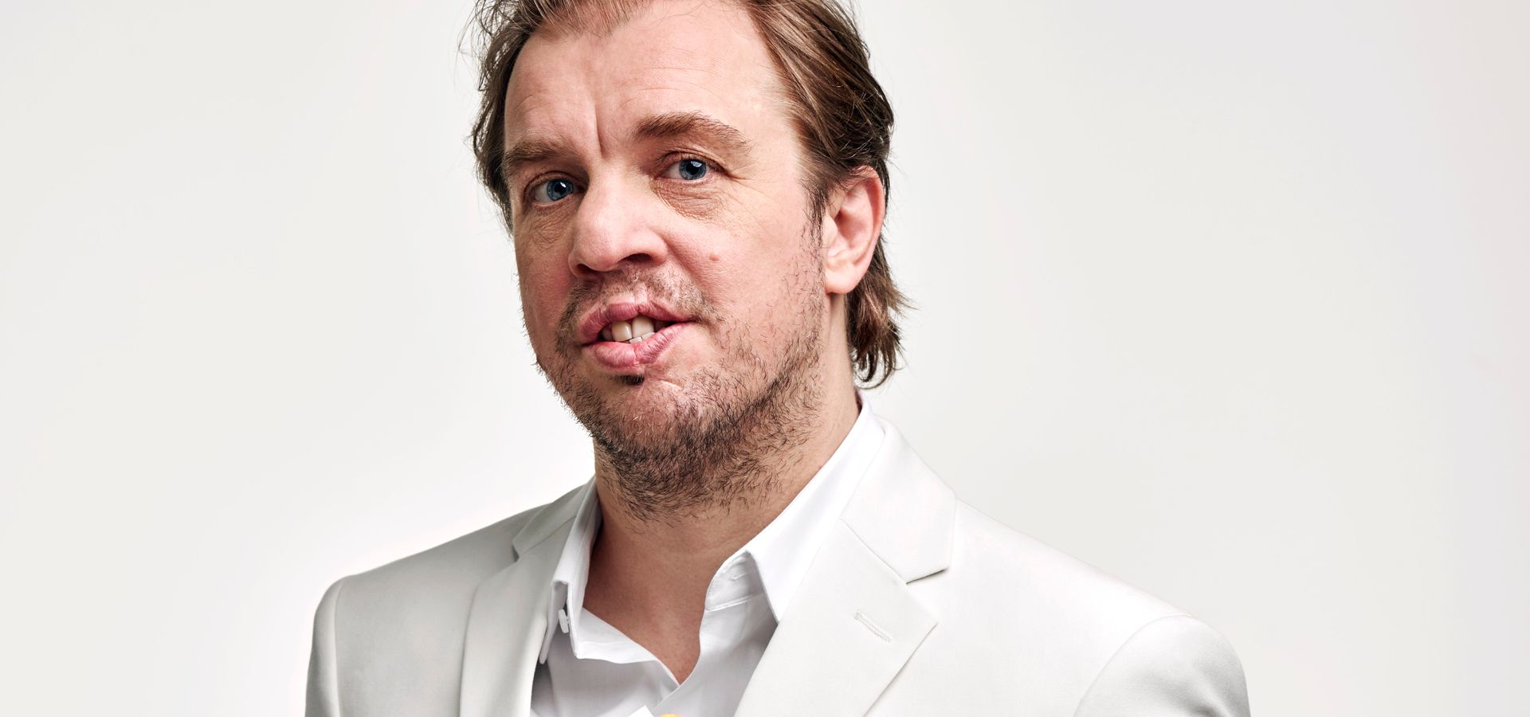

Slide 4
Let’s accept for a moment…

Slide 5


Slide 6

It is a crisis of being, a crisis of the spirit, a crisis of the mind.

Slide 7


Slide 8
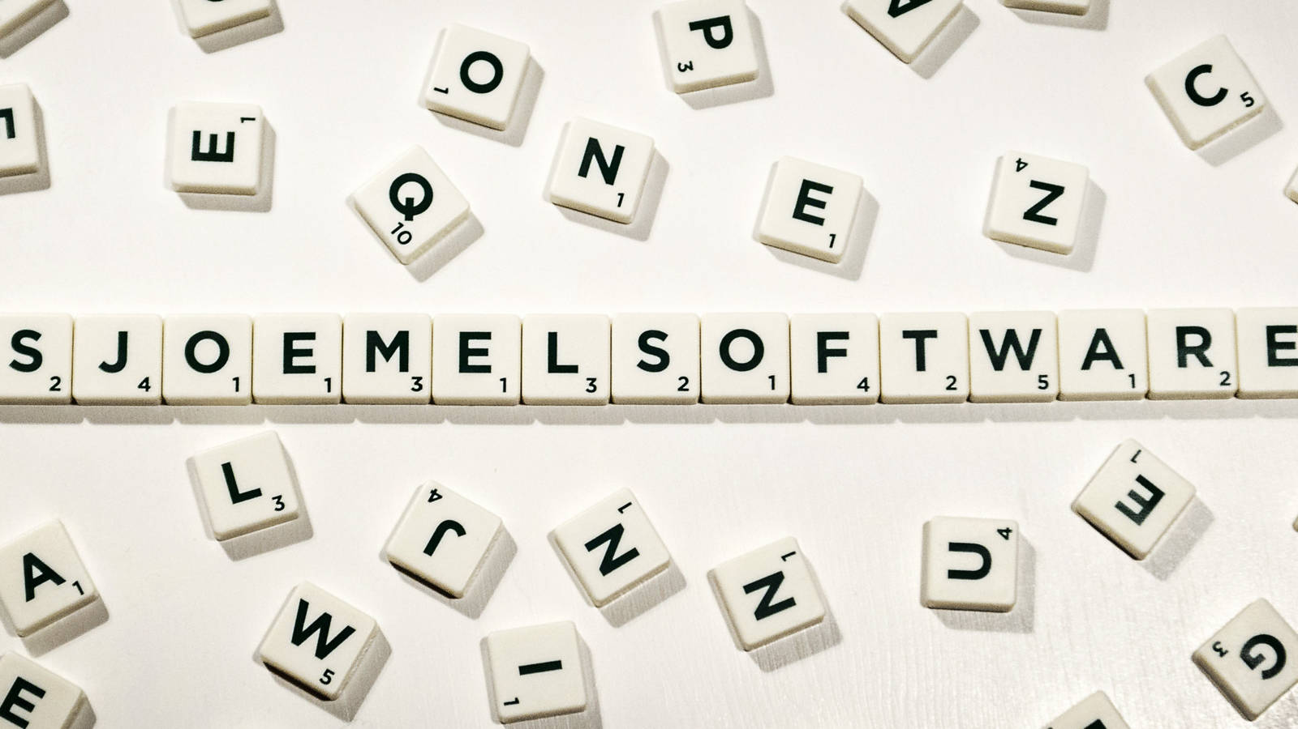

Slide 9

Het Stenen Tijdperk-brein

Slide 10
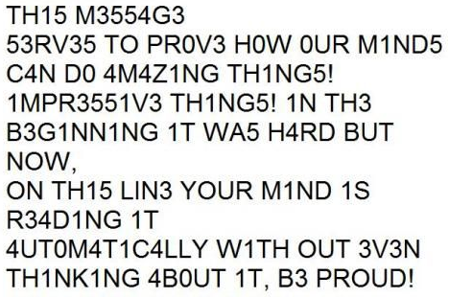

Slide 11

Who thinks s/he is a better than average driver?

Slide 12
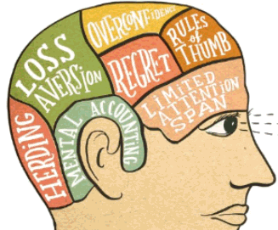

Slide 13
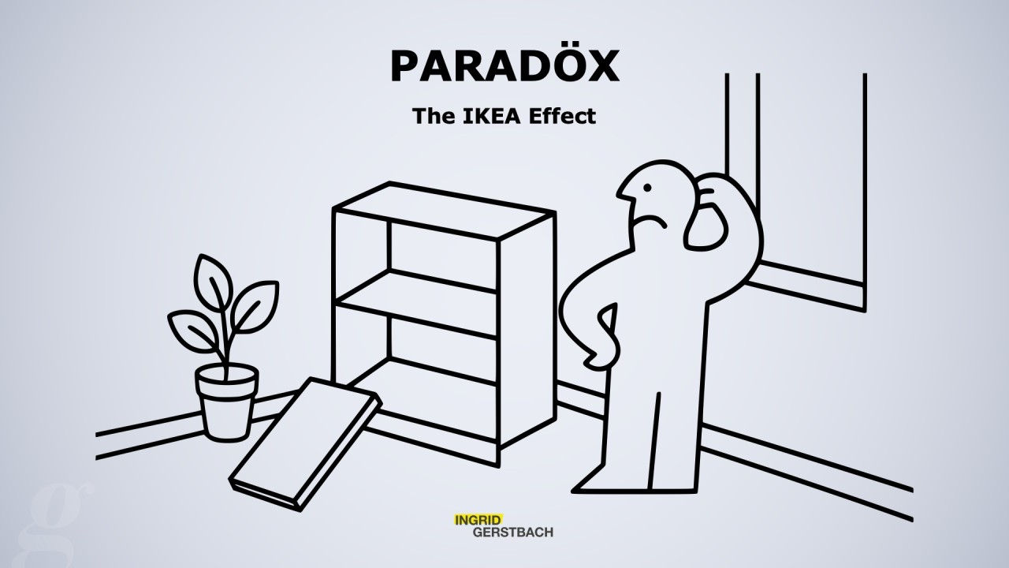

Slide 14
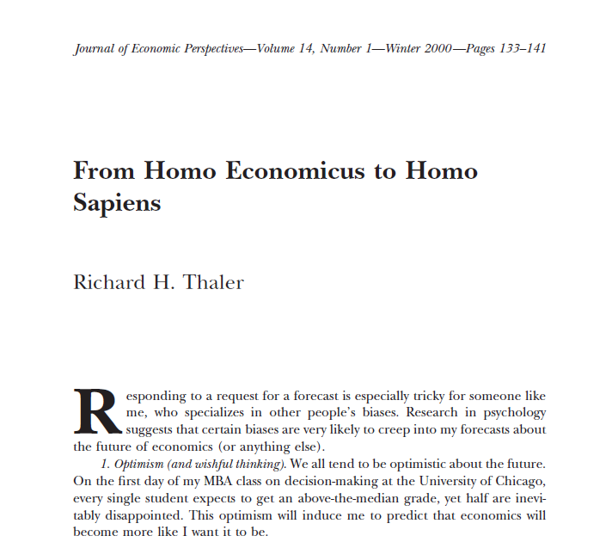
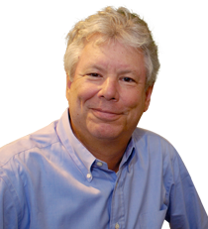

Slide 15


Slide 16
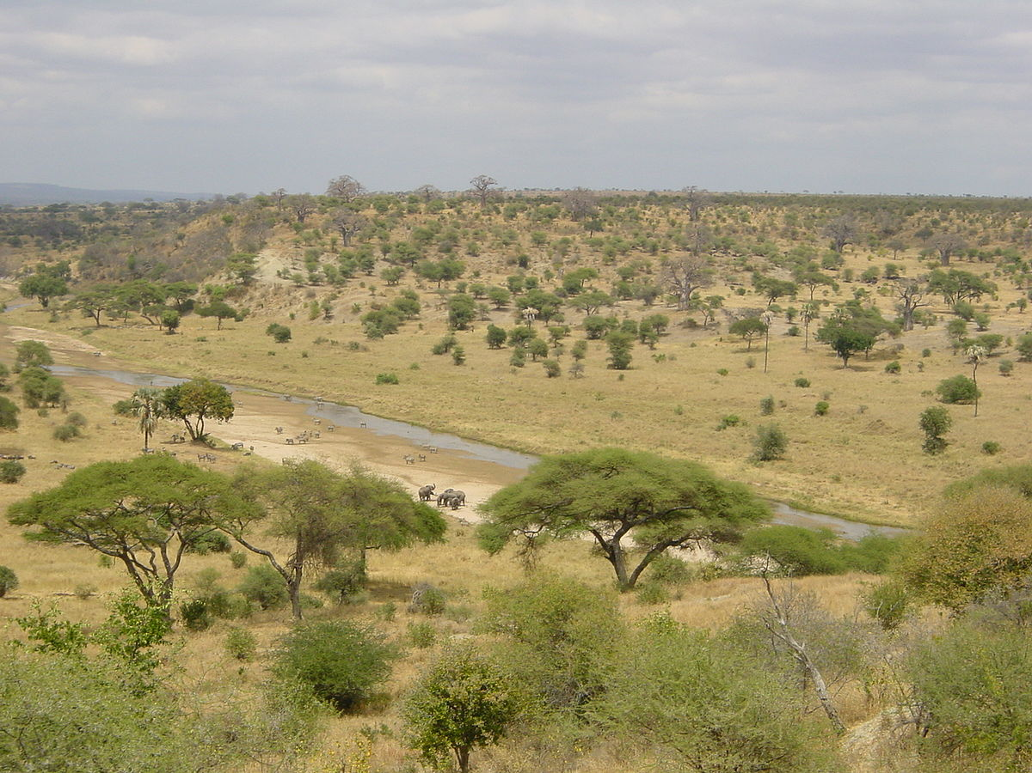
Notes:
Environment of Evolutionary Adaptedness

Slide 17
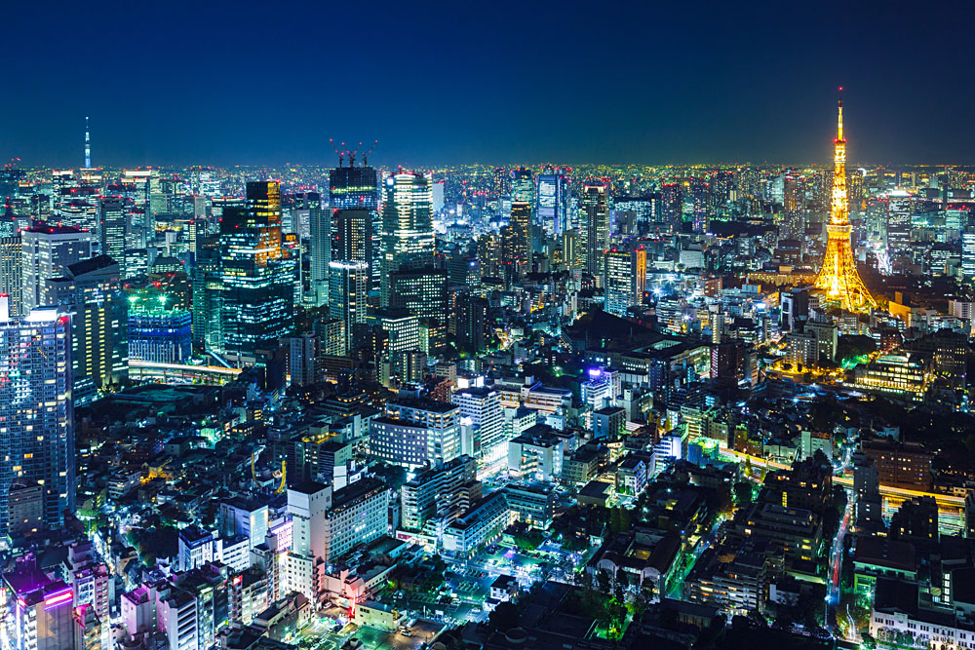
Notes:
Environment of Evolutionary Adaptedness

Slide 18
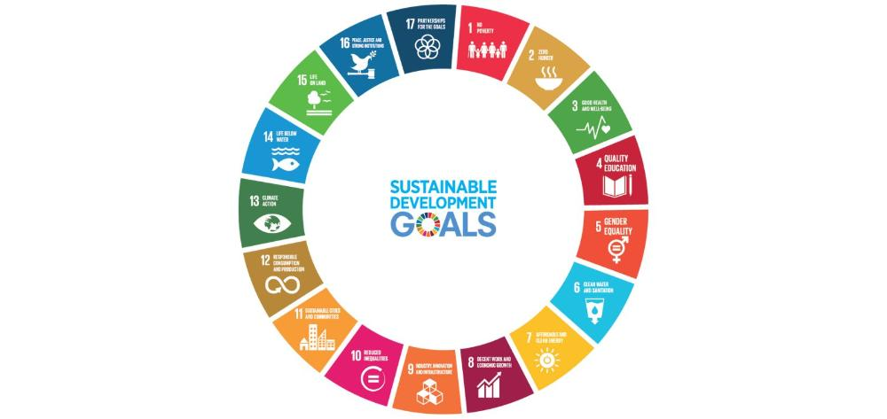


Notes:
Environment of Evolutionary Adaptedness

Slide 19

Self-interest
Short-term
Relative status
Copying
Denial
Notes:
Environment of Evolutionary Adaptedness

Slide 20
Self-interest
Short-term
Relative status
Copying
Denial
Notes:
Environment of Evolutionary Adaptedness

Slide 21
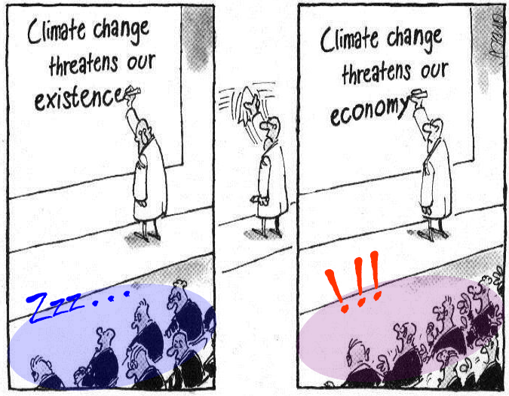

Slide 22
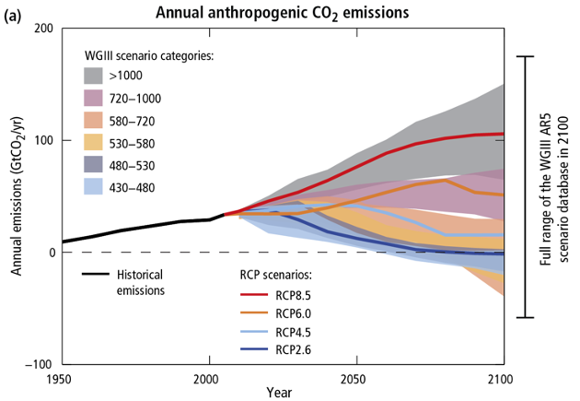

Slide 23

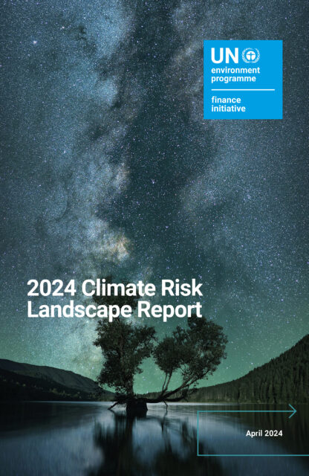
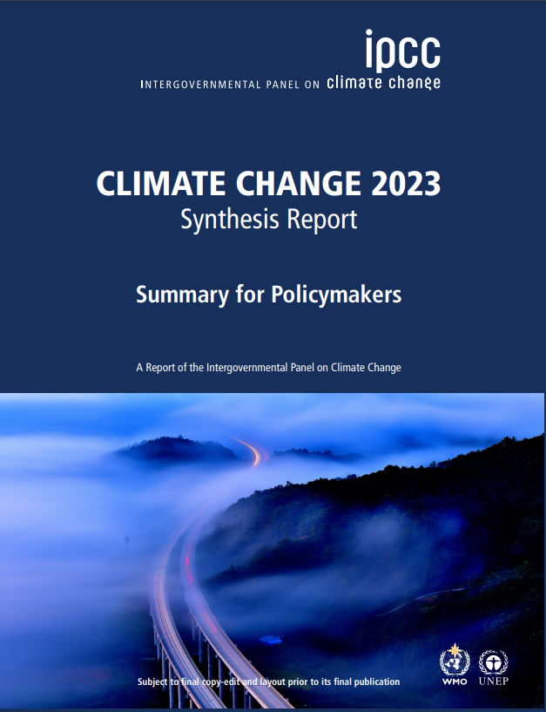
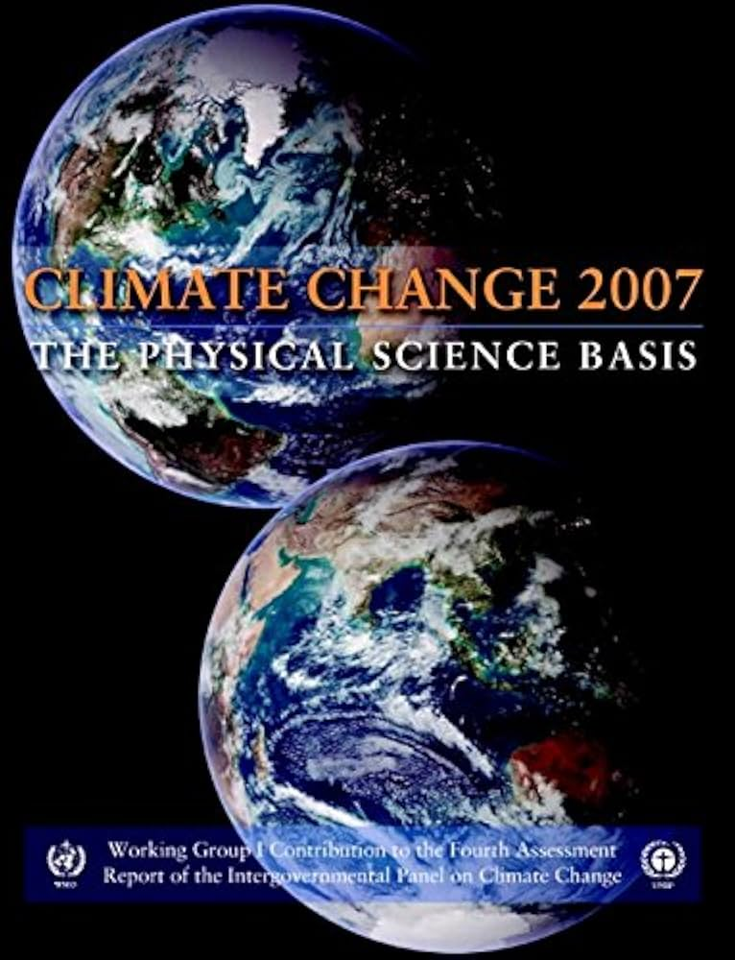
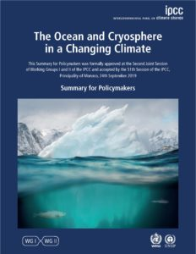

Slide 24
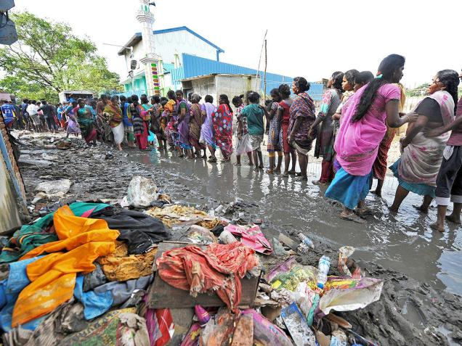
Afstand in plaats

Slide 25
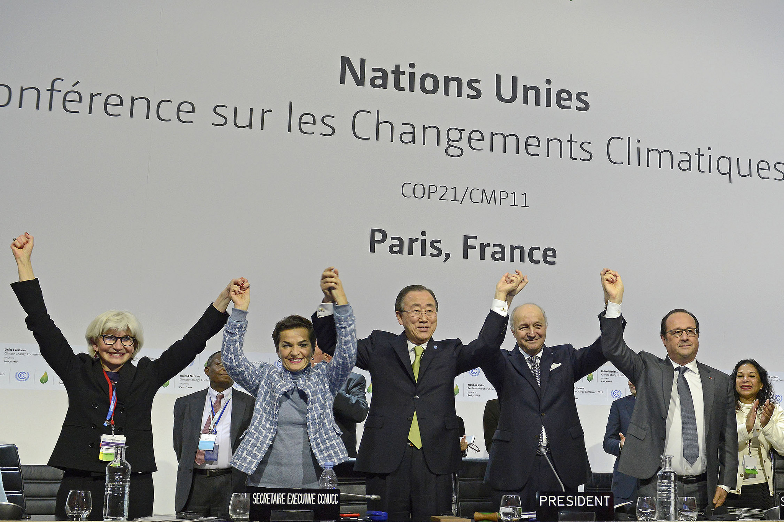
Afstand in plaats

Slide 26
Self-interest
Short-term
Relative status
Copying
Denial
Notes:
Environment of Evolutionary Adaptedness

Slide 27
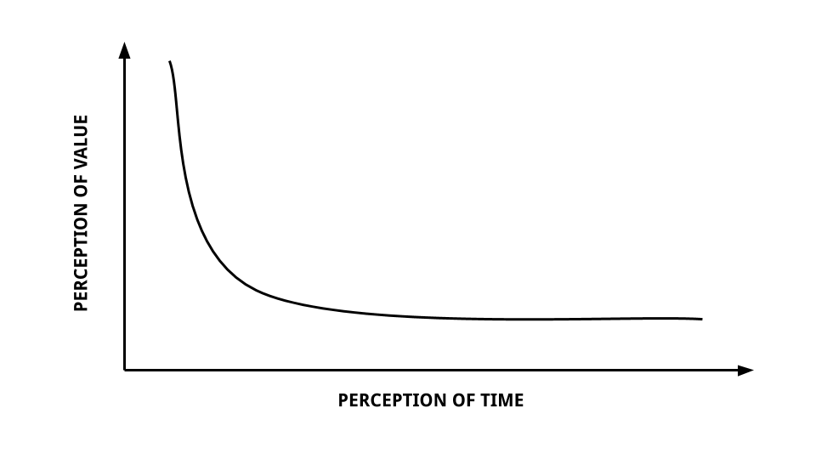

Slide 28
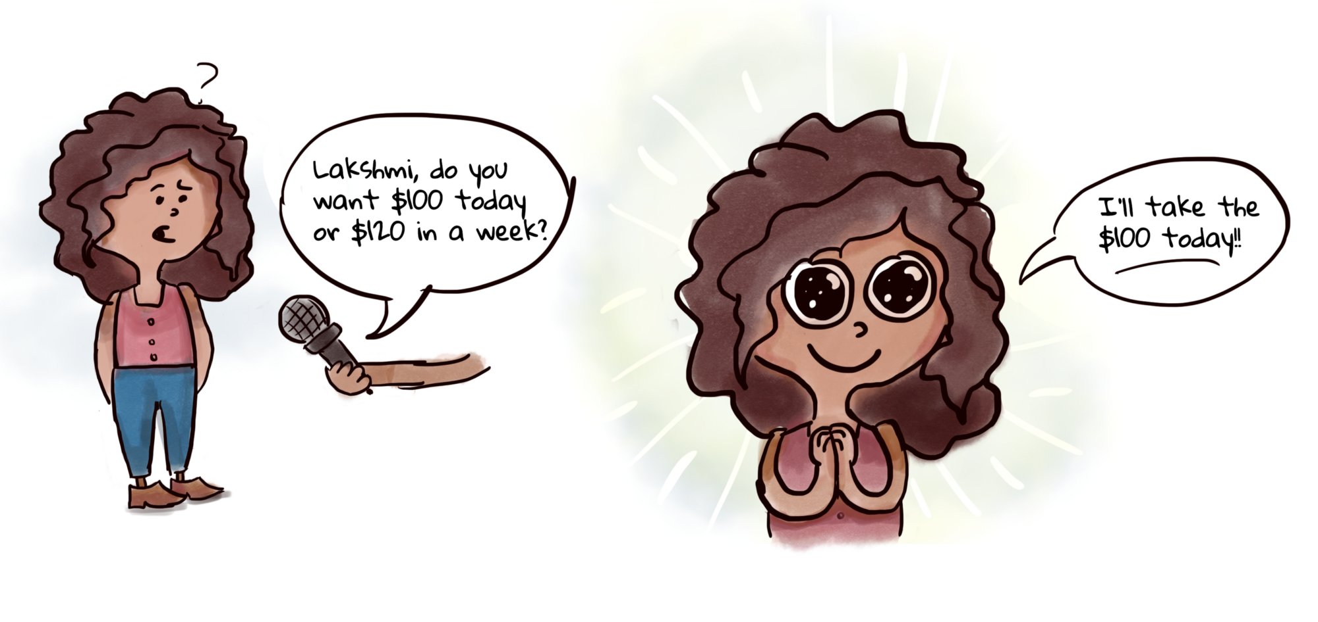

Slide 29
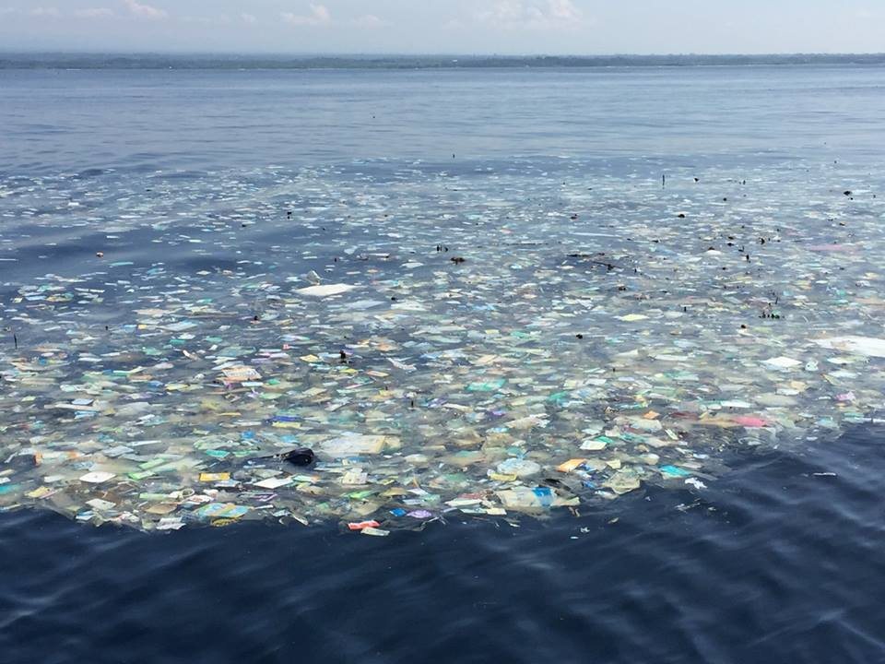
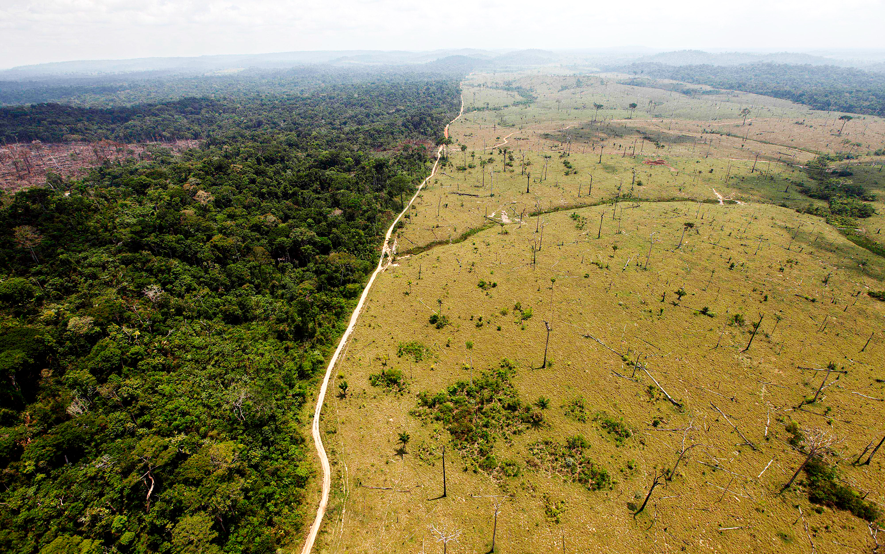
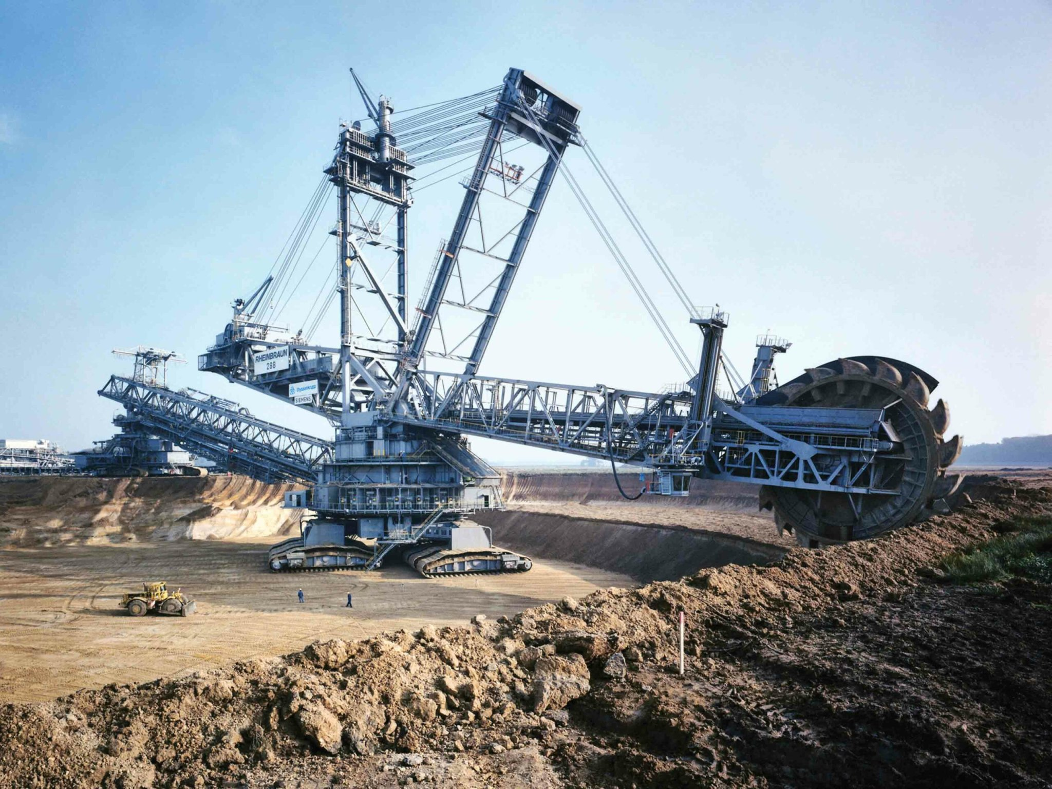
Notes:
Plastic soup plaatje toevoegen

Slide 30
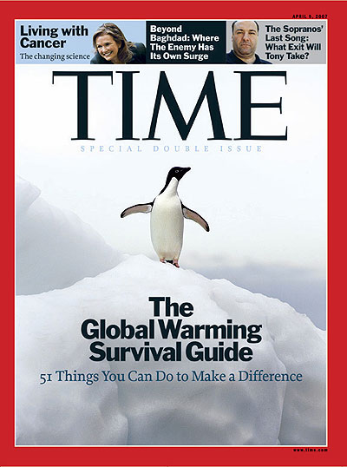
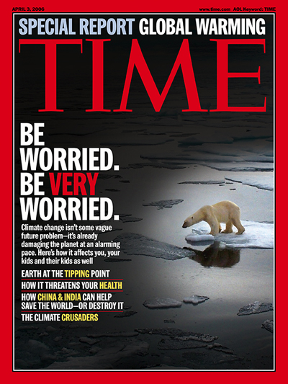
Leads to:
Habituation
Avoidance
Stereotyping

Slide 31
Self-interest
Short-term
Relative status
Copying
Denial
Notes:
Environment of Evolutionary Adaptedness

Slide 32
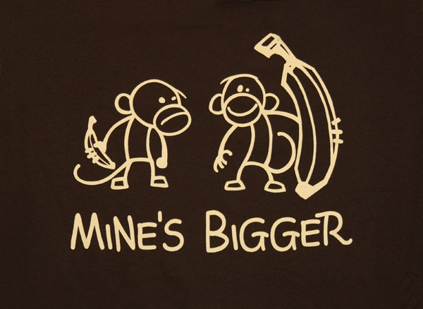
Samenvatting IPCC-rapporten
It’s warming.
It’s us.
It hasn’t stopped.
The heat is mainly in the sea (and that’s bad).
Sea levels are rising.
Ice is shrinking.
CO2 makes the sea more acidic.
CO2 in the air is up 40% since the 1980s.
It’s now the highest in million of years.
Cumulative emissions set the warming.
Reducing emissions limits the warming.
Climate change will last for centuries.
Notes:
Experiment met auto’s in de straat.

Slide 33
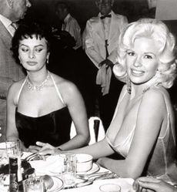
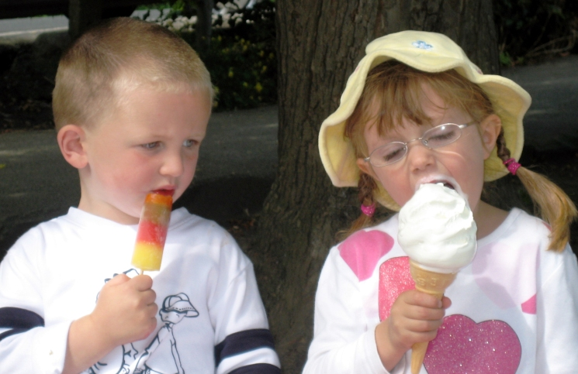

Slide 34
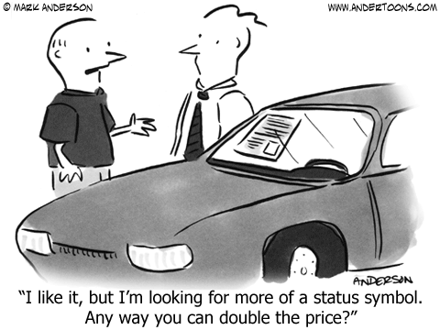
Samenvatting IPCC-rapporten
It’s warming.
It’s us.
It hasn’t stopped.
The heat is mainly in the sea (and that’s bad).
Sea levels are rising.
Ice is shrinking.
CO2 makes the sea more acidic.
CO2 in the air is up 40% since the 1980s.
It’s now the highest in million of years.
Cumulative emissions set the warming.
Reducing emissions limits the warming.
Climate change will last for centuries.

Slide 35



Slide 36
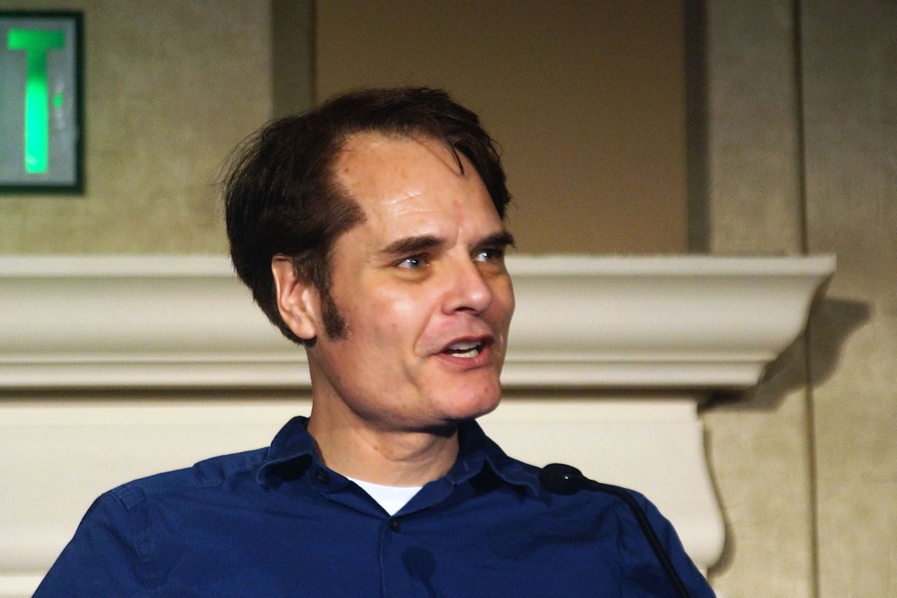
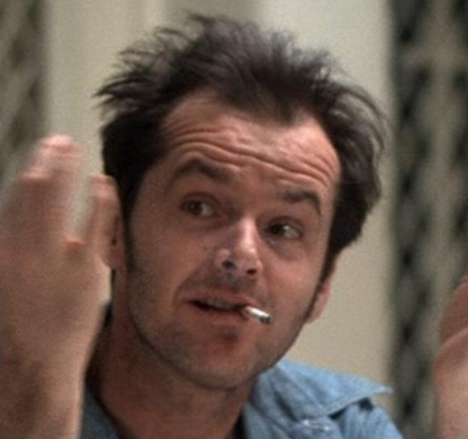
Notes:
Flintstone = vuursteen → van vinken naar vonken, maar vooral oerdriften

Slide 37
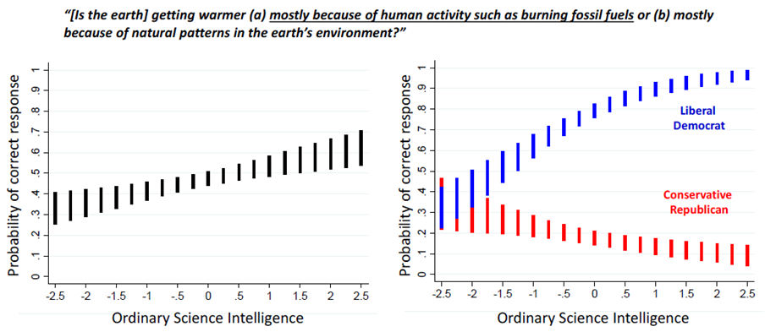

Slide 38
“More numerate subjects use their quantitative reasoning capacity selectively to conform their interpretation of the data to the result most consistent with their political ideology.”
Notes:
Being smarter doesn’t make you more accepting of science, it makes you better able to cherry pick what you need to validate what you already believe. Of, anders gezegd: identity overrides knowledge.

Slide 39
Identity overrides knowledge.

Slide 40
Self-interest
Short-term
Relative status
Copying
Denial
Notes:
Environment of Evolutionary Adaptedness

Slide 41


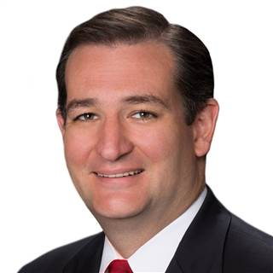
Ted Cruz over klimaatverandering
Climate change is not science.
It’s religion.

Slide 42
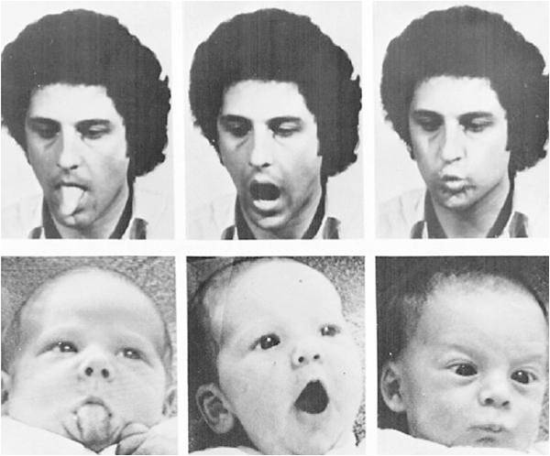

Slide 43
Self-interest
Short-term
Relative status
Copying
Denial
Notes:
Environment of Evolutionary Adaptedness

Slide 44


Slide 45
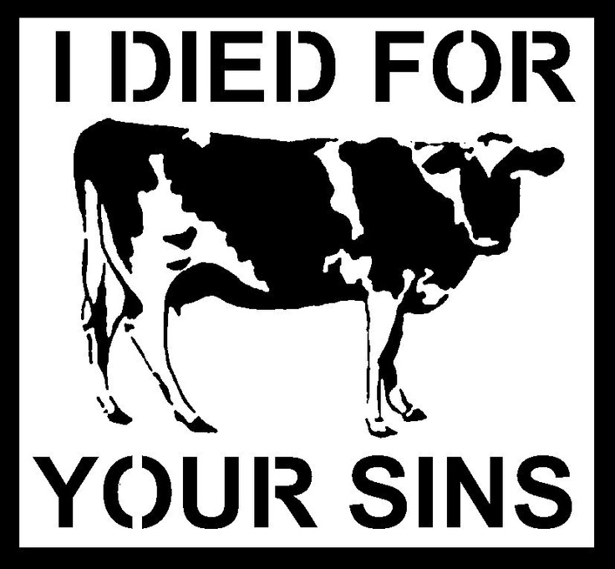

Slide 46

Arjen van der Horst?
We’re f*cked.
Notes:
Onduurzaam gedrag, onduurzame businessmodellen…

Slide 47
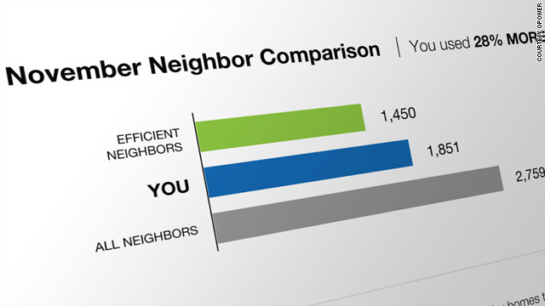

Arjen van der Horst?

Slide 48
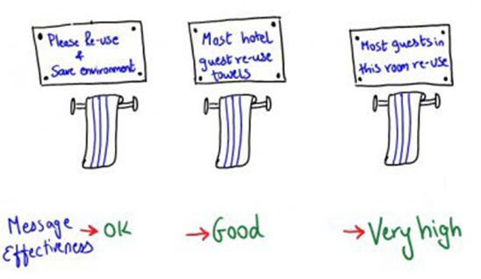
35%
45%
>55%

Slide 49
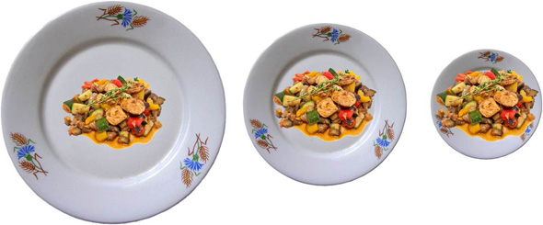

Slide 50
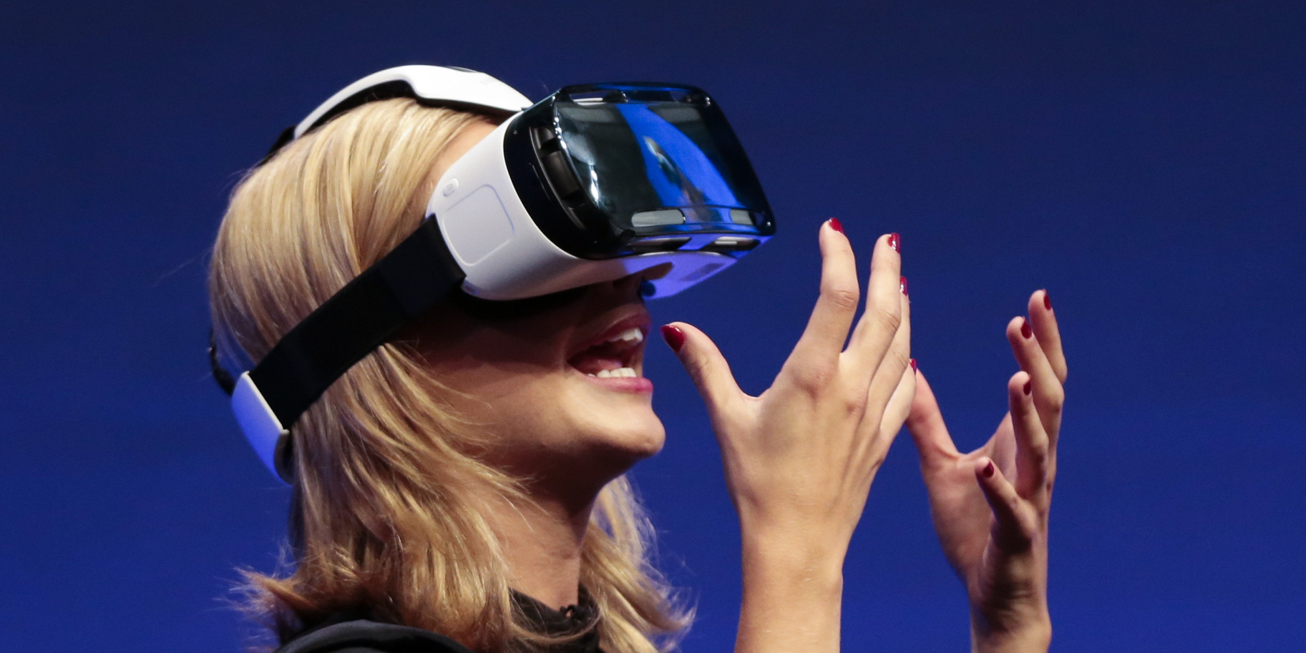

Notes:
Possible selves → opdrachtje?

Slide 51
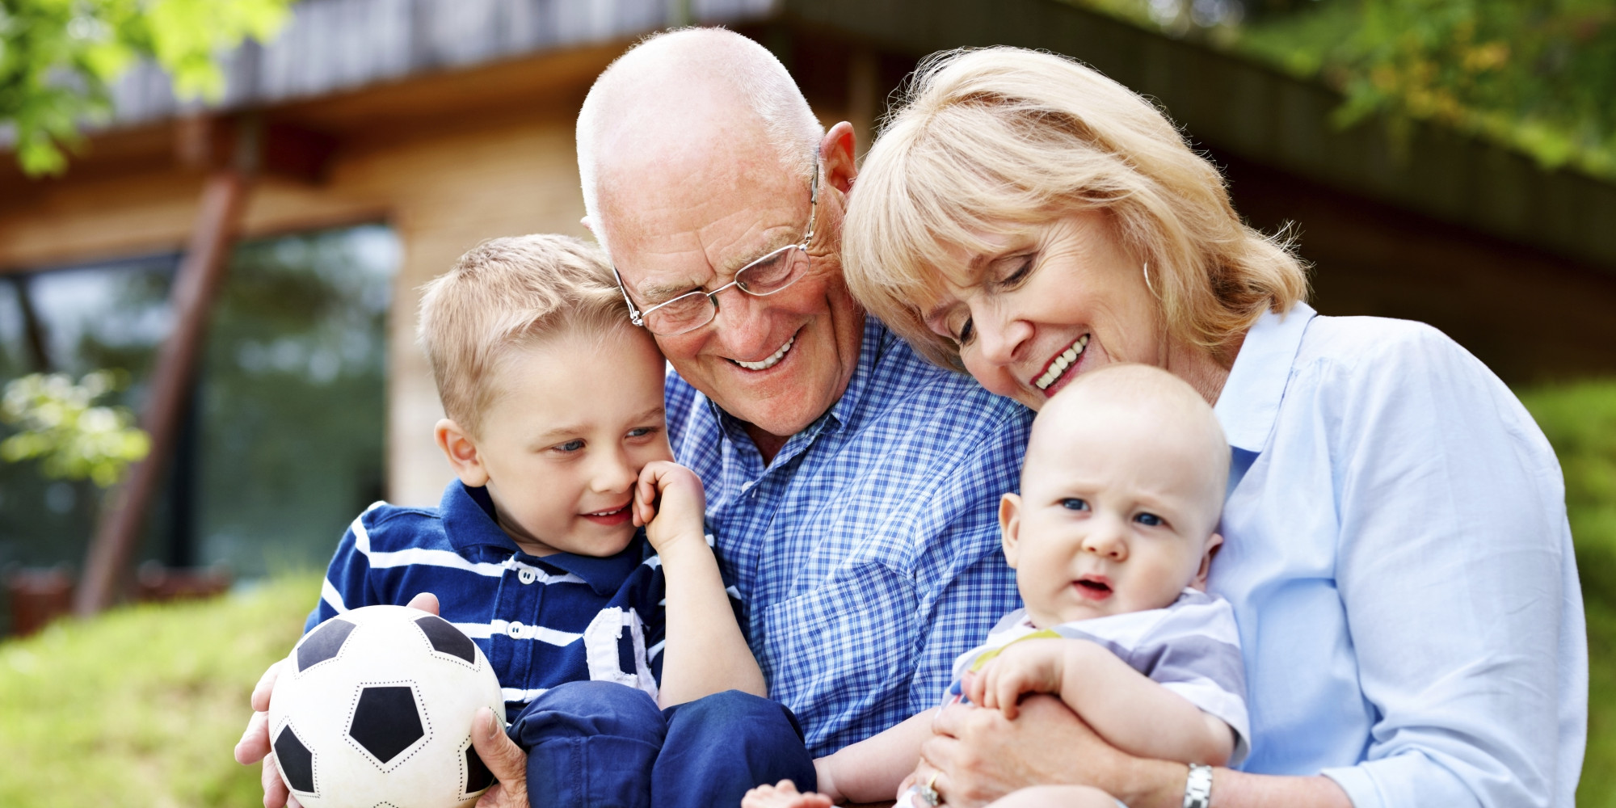
Arjen van der Horst?

Slide 52
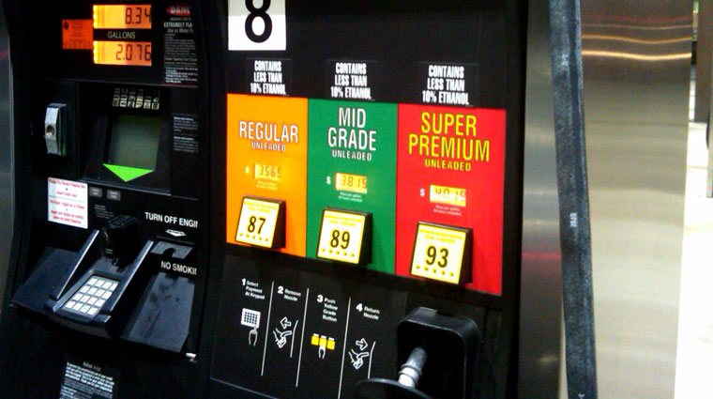
Notes:
Flintstone = vuursteen → van vinken naar vonken, maar vooral oerdriften

Slide 53
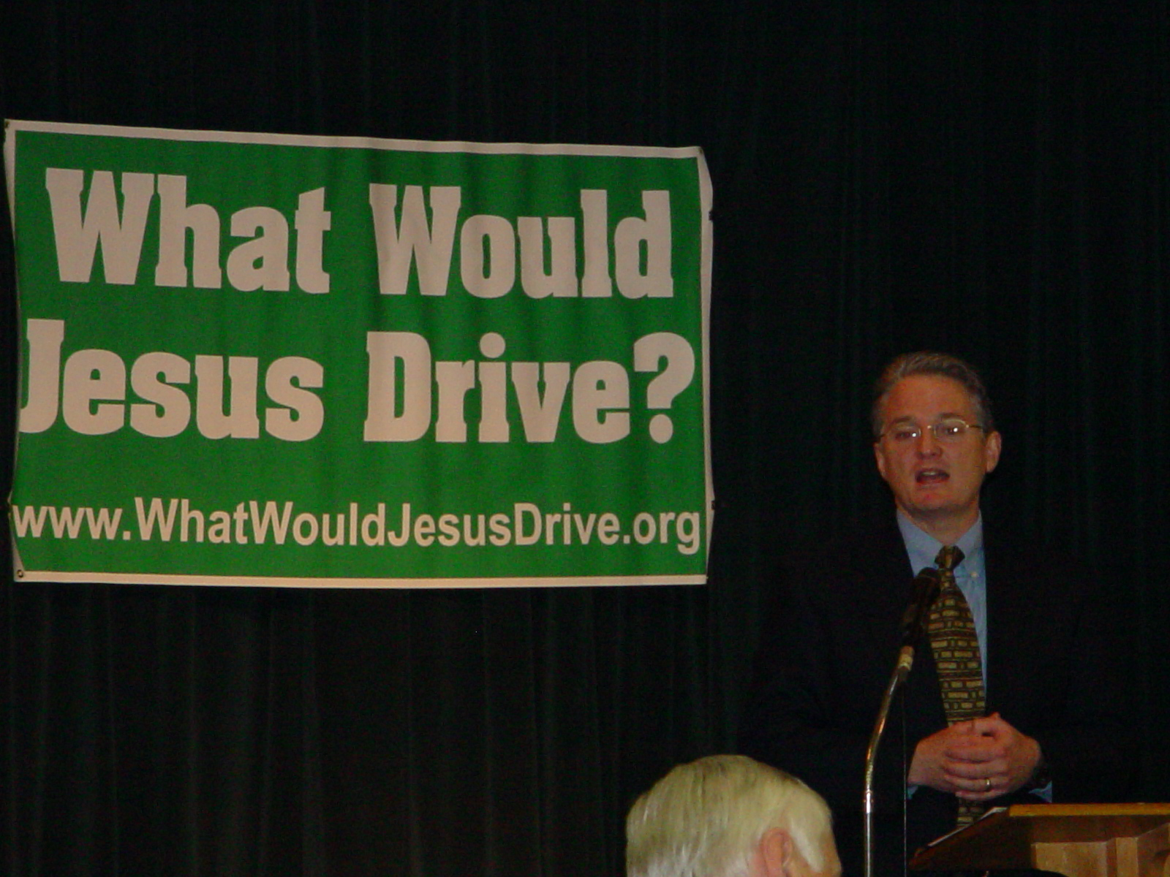
What would Jesus drive?
Notes:
Evangelical Environmental Network’s 2002 “What Would Jesus Drive?” campaign.

Slide 54

“God drove Adam and Eve out of the Garden of Eden in a Fury.”

Slide 55
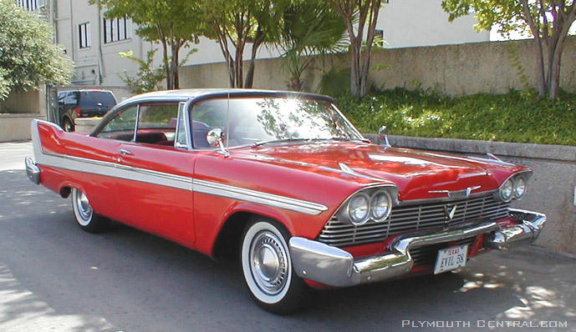
Plymouth Fury
Notes:
Flintstone = vuursteen → van vinken naar vonken, maar vooral oerdriften

Slide 56
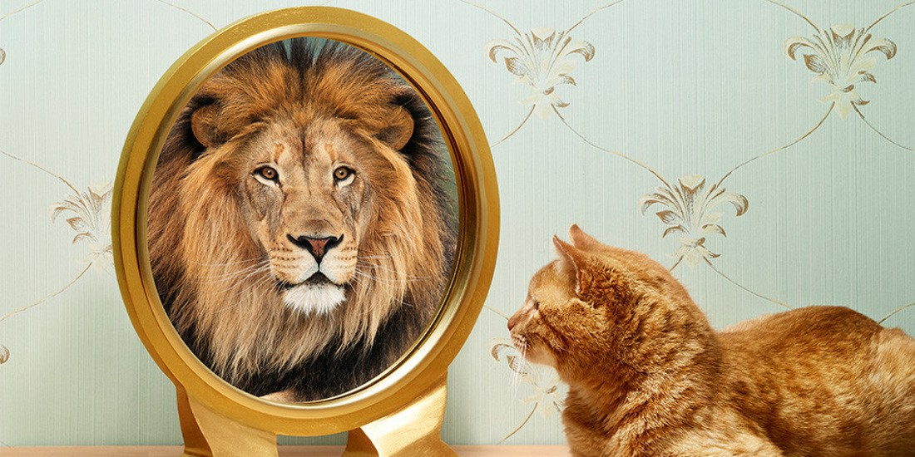
Notes:
Flintstone = vuursteen → van vinken naar vonken, maar vooral oerdriften

Slide 57
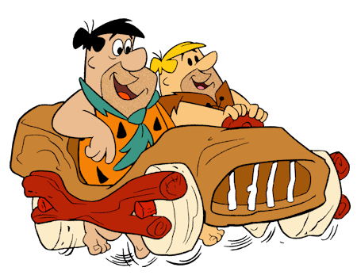
Thank you!

